Slide 1
Introduction To Machine Learning
By Aksadur Rahman
aksadur@yahoo.com

Slide 2
Agenda
What is Machine learning
Types of Machine Learning
Supervised Learning
Unsupervised Learning
Reinforcement Learning
Training data
Test data
Validation data

Slide 3
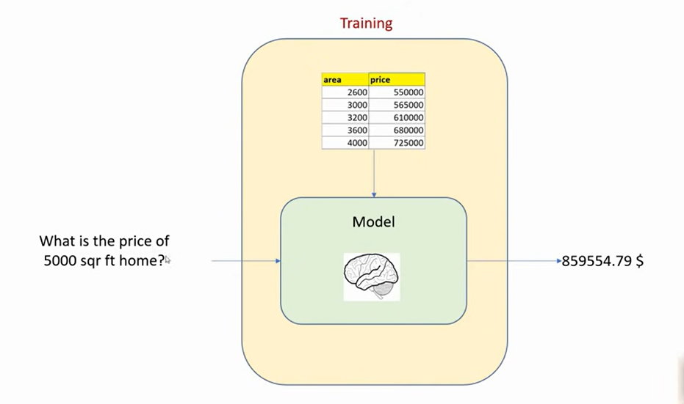
Machine learning:
Machine learning is a branch of Artificial Intelligence (AI) which accepts complex input pattern and output intelligent decisions.

Slide 4
Supervised Learning:
Supervised learning is a type of machine learning. It is basically a synonym of classiﬁcation. The supervision in the learning comes from the labeled instances in the training data.
For Example
Weather | Humidity | Wind | Play
Sunny | High | Week | No
Sunny | Normal | Week | No
Sunny | Normal | Strong | No
Cloudy | High | Week | No
Cloudy | High | Strong | No
Cloudy | Normal | Strong | Yes
Cloudy | Normal | Week | Yes
Rainy | High | Week | Yes
Rainy | Normal | Strong | Yes
Rainy | Normal | Week | Yes
Sunny | High | Strong | ???

Slide 5
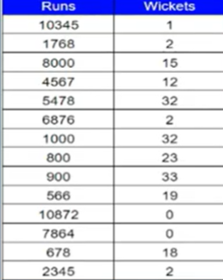
Unsupervised Learning:
Unsupervised learning is a type of machine learning. It is essentially a synonym of clustering. The learning process is unsupervised since the input instances are not class labeled.
Example
How many player are batsman, baller and al rounder?

Slide 6
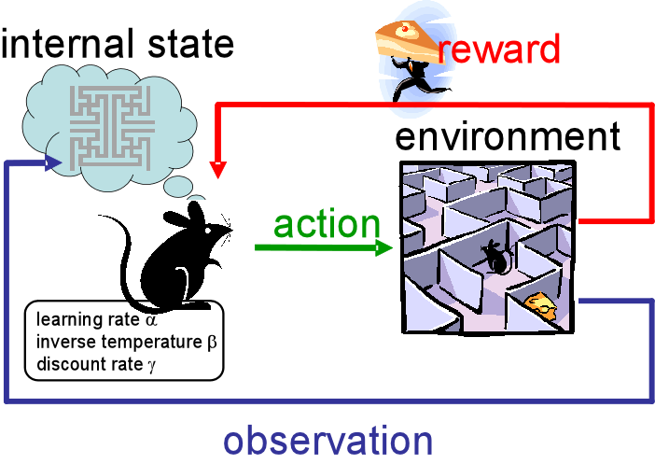
Reinforcement Learning
It is neither based on supervised learning nor unsupervised learning. Moreover, here the algorithms learn to react to an environment on their own. It is rapidly growing and moreover producing a variety of learning algorithms. These algorithms are useful in the field of Robotics, Gaming etc.

Slide 7
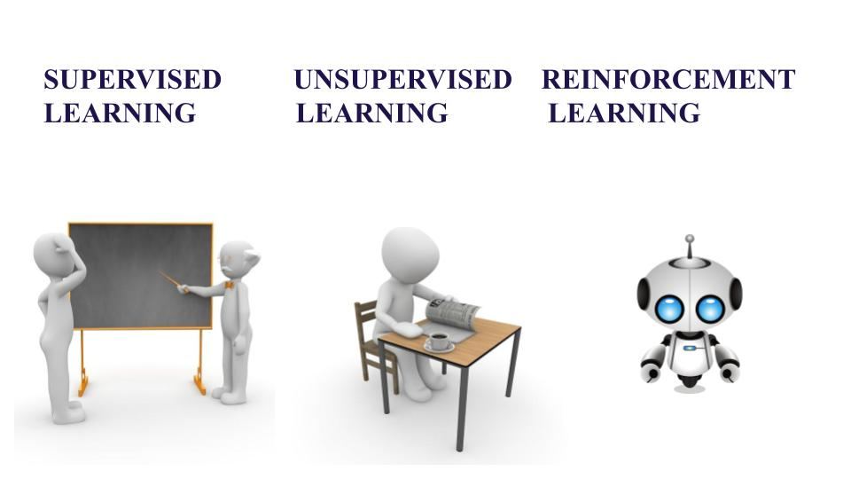

Slide 8
Criteria | Supervised ML | Unsupervised ML | Reinforcement ML
Definition | Learns by using labelled data | Trained using unlabelled data without any guidance. | Works on interacting with the environment
Type of data | Labelled data | Unlabelled data | No – predefined data
Type of problems | Regression and classification | Association and Clustering | Exploitation or Exploration
Supervision | Extra supervision | No supervision | No supervision
Algorithms | Linear Regression, Logistic Regression, SVM, KNN etc. | K – Means, C – Means, Apriori | Q – Learning, SARSA
Aim | Calculate outcomes | Discover underlying patterns | Learn a series of action
Application | Risk Evaluation, Forecast Sales | Recommendation System, Anomaly Detection | Self Driving Cars, Gaming, Healthcare

Slide 9
Training data:
This type of data builds up the machine learning algorithm. The data scientist feeds the algorithm input data, which corresponds to an expected output.
Test data:
After the model is built, testing data once again validates that it can make accurate predictions.

Slide 10

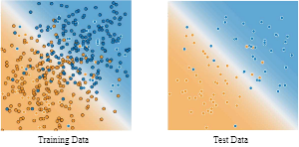
Splitting Data
It is called Train/Test because you split the data set into two sets: a training set and a testing set.
May be, 80% for training, and 20% for testing.

Slide 11
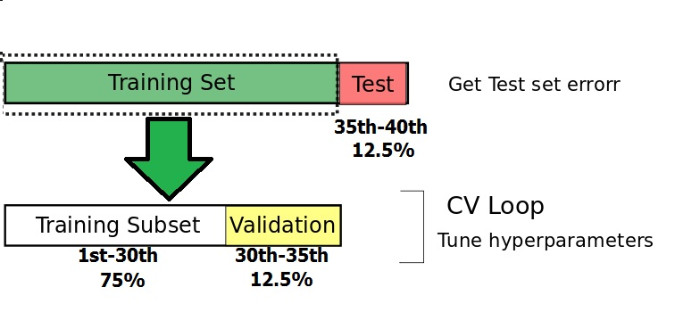
Validation data
The "validation data" is a set of data held separate from your training data. It's used during the training process to give an estimate of model skill while tuning model’s hyperparameters.

